Slide 1
Housing Data
Predicting Iowa house prices (2006 – 2010)

Slide 2
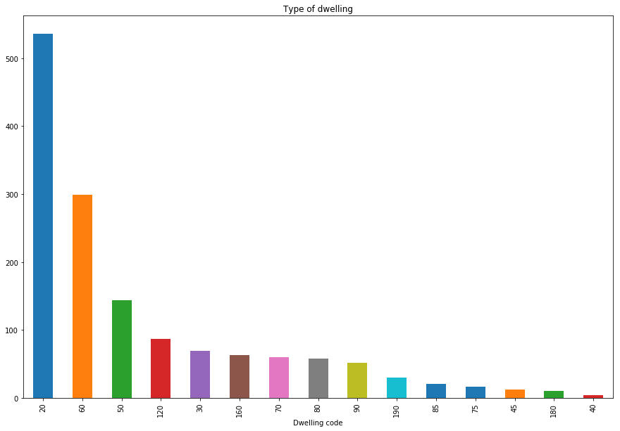
Exploratory Data Analysis
Notes:
What’s the distribution of house types?

Slide 3
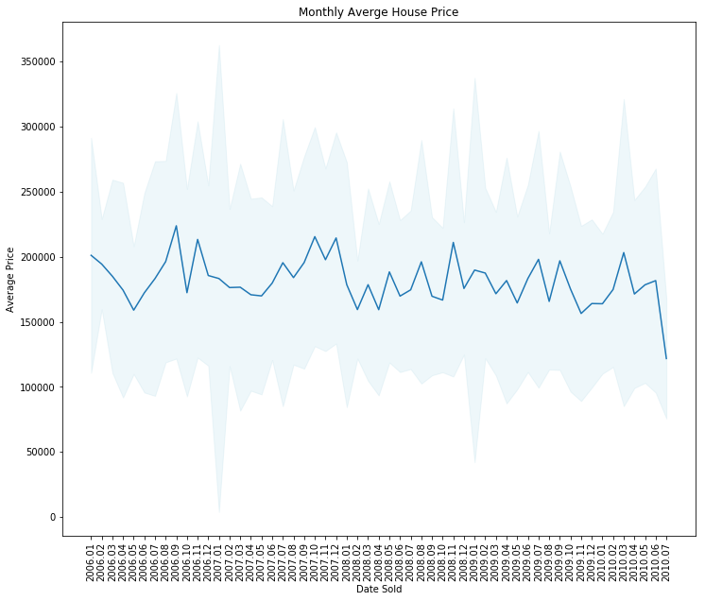
Exploratory Data Analysis
Notes:
What kind of trend does the SalePrice have?

Slide 4
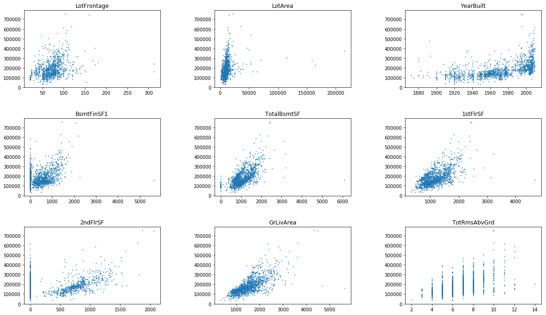
Exploratory Data Analysis
Notes:
What are some of the features that have a relationship with the target variable, SalePrice.

Slide 5
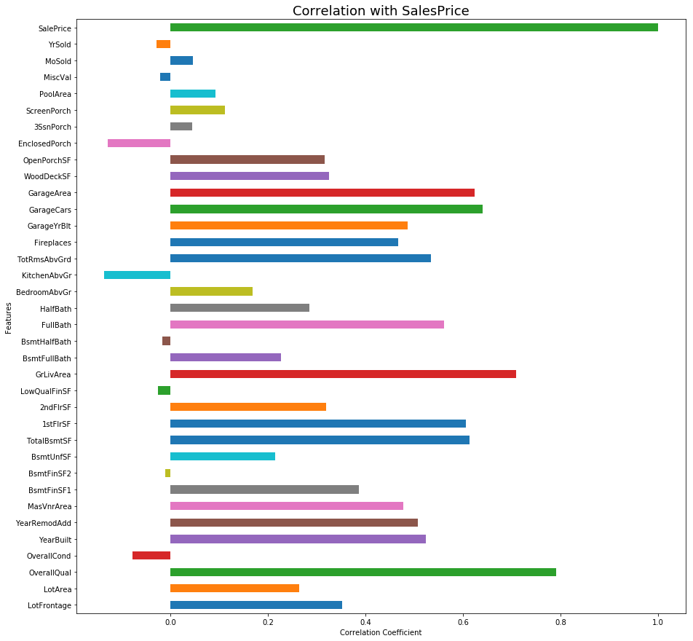
Potential Predictors
Notes:
What features have a high correlation with SalesPrice. These are potential predictors.

Slide 6
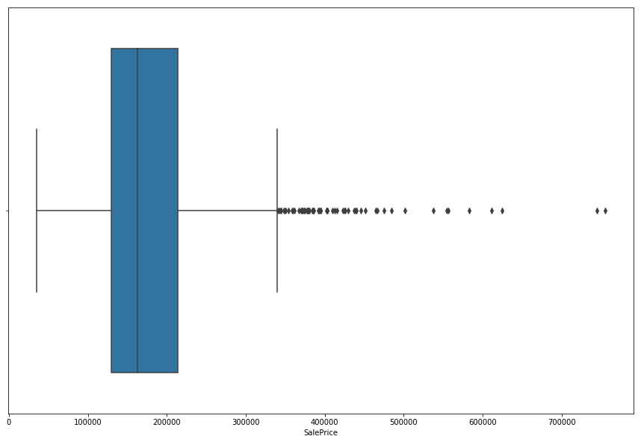
Data Processing
NaN values were replaced with an identifier that indicated that the house did not have this feature, or the mean value.
Eg, 2ndFlrSF = 0, because there was no second floor; or
GarageYrblt = mean value
I removed outliers from the several main features (LotFrontage, TotalBsmtSF, salePrice)
Values greater than 3 std’s away from the mean were removed (101).
Notes:
Data processing steps that I tried. The ones that worked and the ones that didn’t.
101 outliers were removed.

Slide 7
Data Processing
I tried converting the categorical features that were related to an order to ordinal numerical values
Ie, the features relating to quality or condition.
I tried converting the remaining categorical variables to dummy variables.
Resulting in 275 features
I tried Scaling the data
This resulted in a significant increase in the MSE (mean squared error)
Later found out that the linear regression models automatically scale the data
Notes:
Data processing steps that increased complexity of the model.

Slide 8
Feature Engineering
I created 3 additional features
1. The average SalePrice last year
2. The average SalePrice in each neighbourhood last year
3. The average SalePrice for each building class last year
Notes:
3 new features relating to the average price in the previous year.

Slide 9
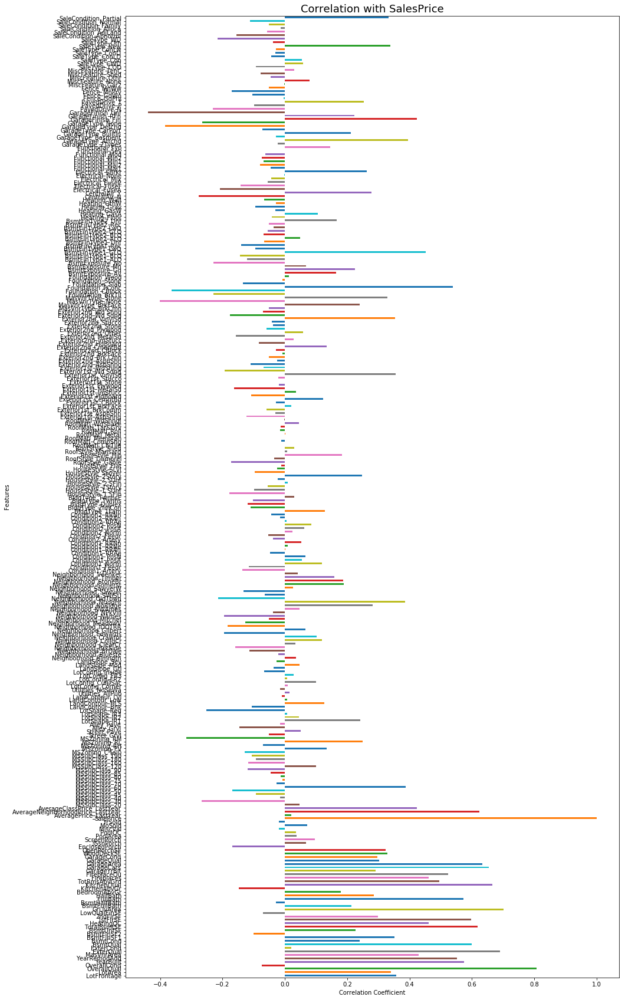
Potential Predictors – update 278 features
Notes:
Updated potential predictors with the 275+3 features.

Slide 10
Modelling
Tried running the linear regression model with the default hyperparameters (all 278 features)
Adjusted R² = 1.138 (not realistic)
Tried other linear models (LassoCV, RidgeCV, PassiceAgressiveRegressor, BaggingRegressor, SVR)
The RidgeCV model performed slightly better than the LinearRegression model, giving an additional 0.02 increase in R² (unadjusted R²).
Notes:
Modelling process.

Slide 11
Model Optimisation
I applied forward feature selection on all the models to choose the best model and feature set.
LinearRegression won out with adjsuted R² of 0.912
Then I applied an optimisation function to tune the hyperparameters
Fit_intercept
normalise
Adjusted R² = 0.913
Notes:
Model selection and optimisation.

Slide 12
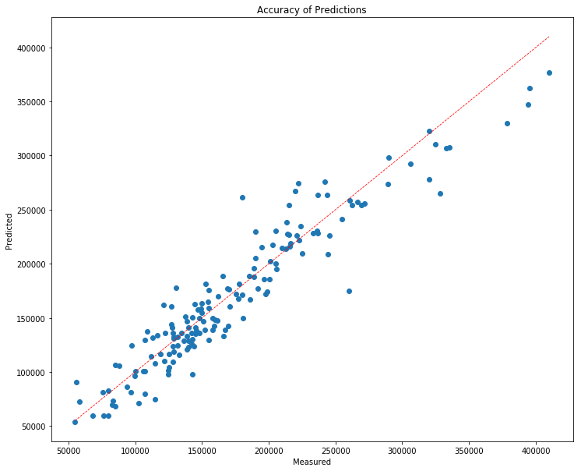
Model Performance
Optimised LinearRegression model with Forward feature selection (30 features):
Adjusted R² = 0.913
The model performs reasonably well, except for the more expensive models, where there isn’t as much data available.
The model under estimates the value of the house’s greater than $300,000
Notes:
Best results

Slide 13
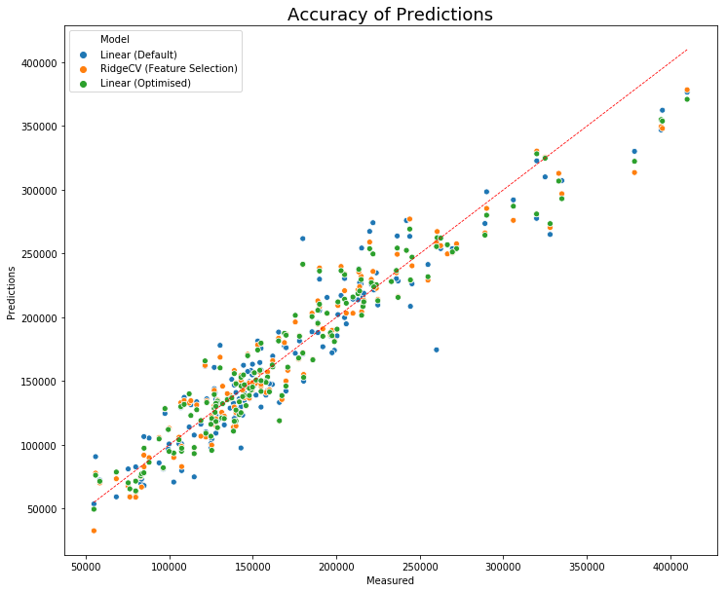
Comparison of Models Used
Linear (Default) R²: 1.138
RidgeCV (Feature Selection) R²: 0.909
Linear(Optimised) R²: 0.913
Notes:
Model comparison.

Slide 14
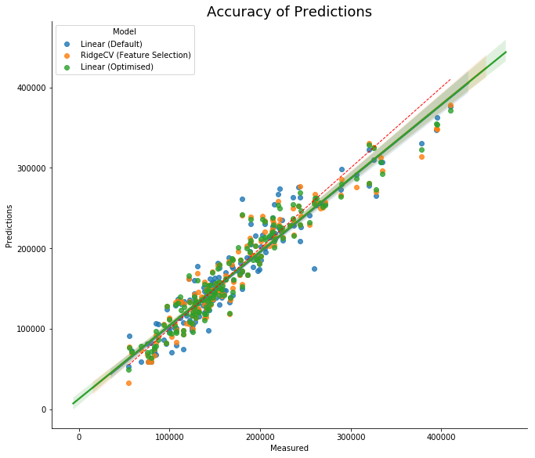
Notes:
Was the extra work worth it?
No, all models appear to perform the same

Slide 15
Thank you

